Slide 1
Diocese of Buffalo Transition Team Training Saturday, October 12, 2024

Slide 2
Agenda
Opening Prayer
Transition Team Defined
Transition Team Makeup
Transition Team Tasks
Ideas for mergers/closures
Starting a new parish
Collaboration

Slide 3
Opening Prayer

Slide 4


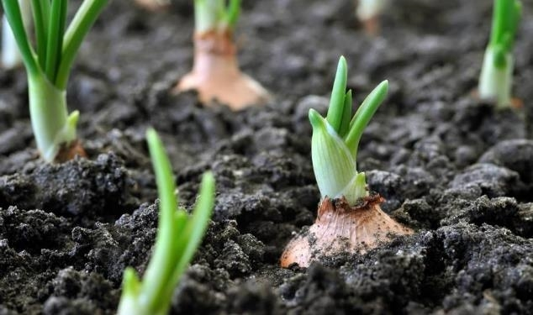
Transition team: group of people collaborating with leadership to help the family and parishes transition in the merger/closure process.

Slide 5

Transition Team Make-up
Key to success

Slide 6
Attributes of Transition team members
Prayerful, spiritual individual guided by the Holy Spirit.
Leader who is supportive and open to the Renewal process.
Uses skills for the betterment of entire family.
Willing to dialogue about and embrace change.
Must be a good communicator, respecting information and processes.
Positive outlook and attitude.
Organized.

Slide 7
Who makes up the Transition team
Current leadership team members – trustees
Pillar leadership members
Positive, organized people
Those who are going to help make transition as smooth and collaborative as possible.
Open minded people in leadership roles who can deal with change
These can come from parish council, financial council, family leadership team, family council, trustees, etc.

Slide 8
Who makes up the Transition team
Should be made up of people from entire family of parishes
The parishes that are merging/closing can have larger representation
Size of the team is up to the pastor (recommended no more than 12 people)
Current pillar team members – if possible, each pillar should be represented
If an already existing leadership group can meet all these needs and you do not believe you need another group, feel free to use their resources and abilities to perform the functions of the transition team

Slide 9
T^3 Transition Team tasks
Pray for transition – pray over the pews.
Organize and help implement transitions of mergers/closures.
Organize and help implement newly merged parishes.
Implement Radical Hospitality
How?
Celebrate the heritage of parishes that are merging/closing.
Inventory of traditions, celebrations, ministries, outreach of all parishes coming together.
Look to ritualizing mergers, closures and new beginnings.

Slide 10
Show Hospitality in Transition View these 3 short videos on “Building a Culture of Hospitality in your Parish” by rebuilt. It is a series of 3 excellent videos that are about 30 minutes. Bring your whole team to watch them together: Hospitality | Week 1 | Stephanie Downes Hospitality | Week 2 | Analia Kolakowski Hospitality | Week 3 | Fr. Michael White

Slide 11
collaboration
Transition team needs to collaborate with:
Priest/Deacon leadership
Pillar teams – engage them
Ministry leaders – invite and engage
Parishioners & Staff
Opportunities for parishioner involvement:
Prayer ministry for transition
Accompaniment – involvement in transition implementation
Culture of welcome/hospitality

Slide 12
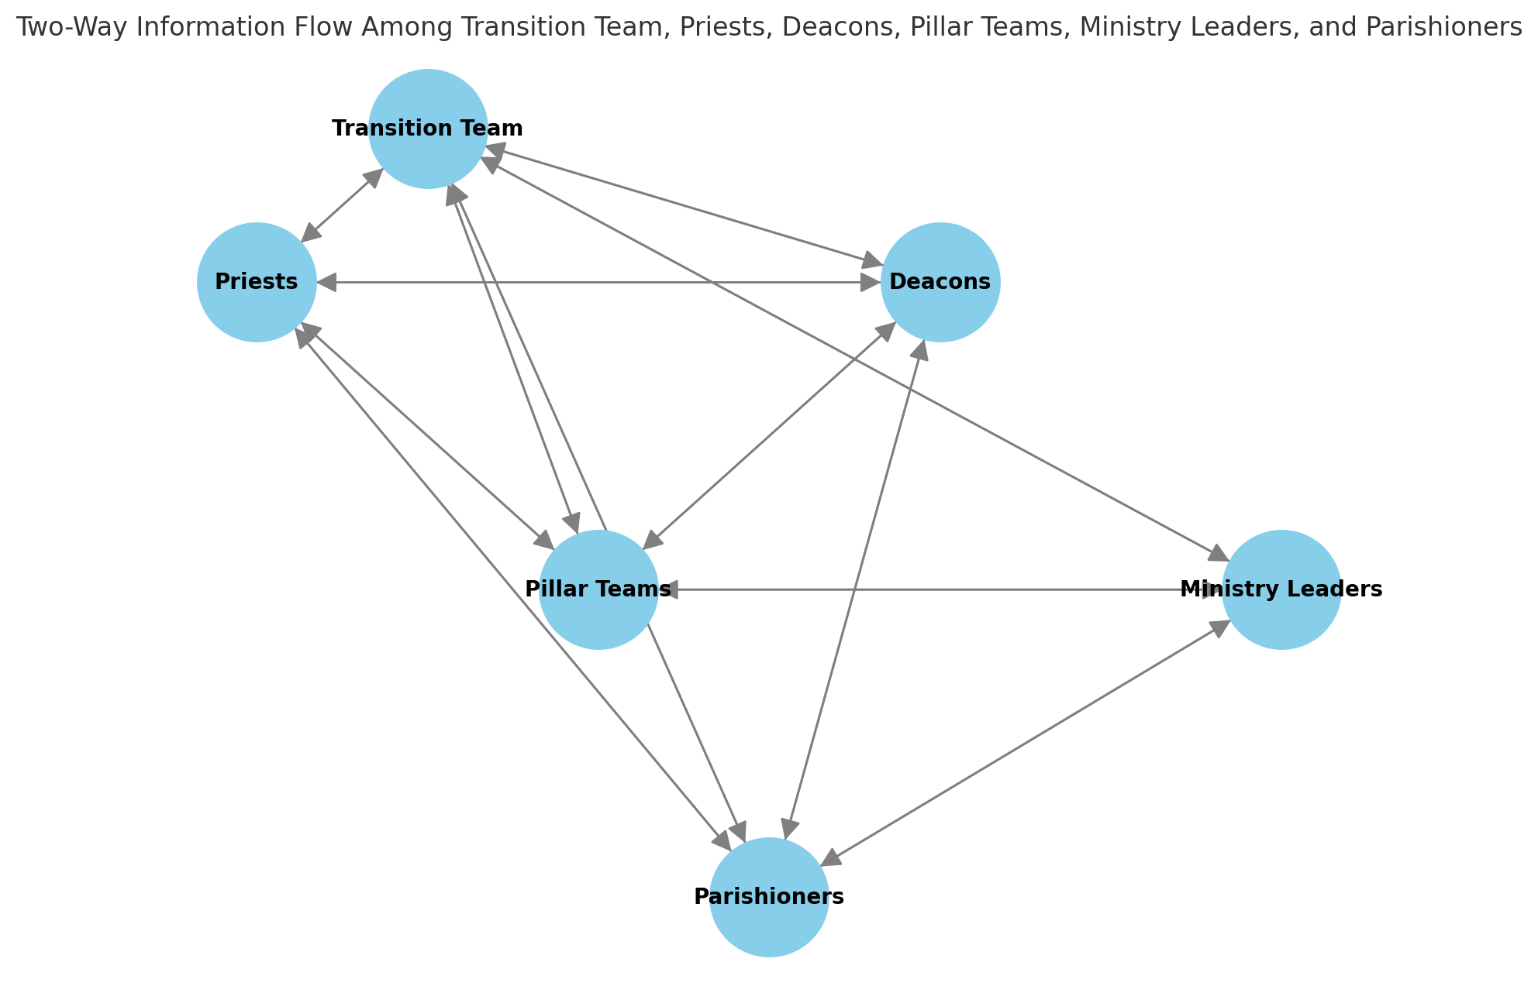
True Collaboration
& Staff

Slide 13
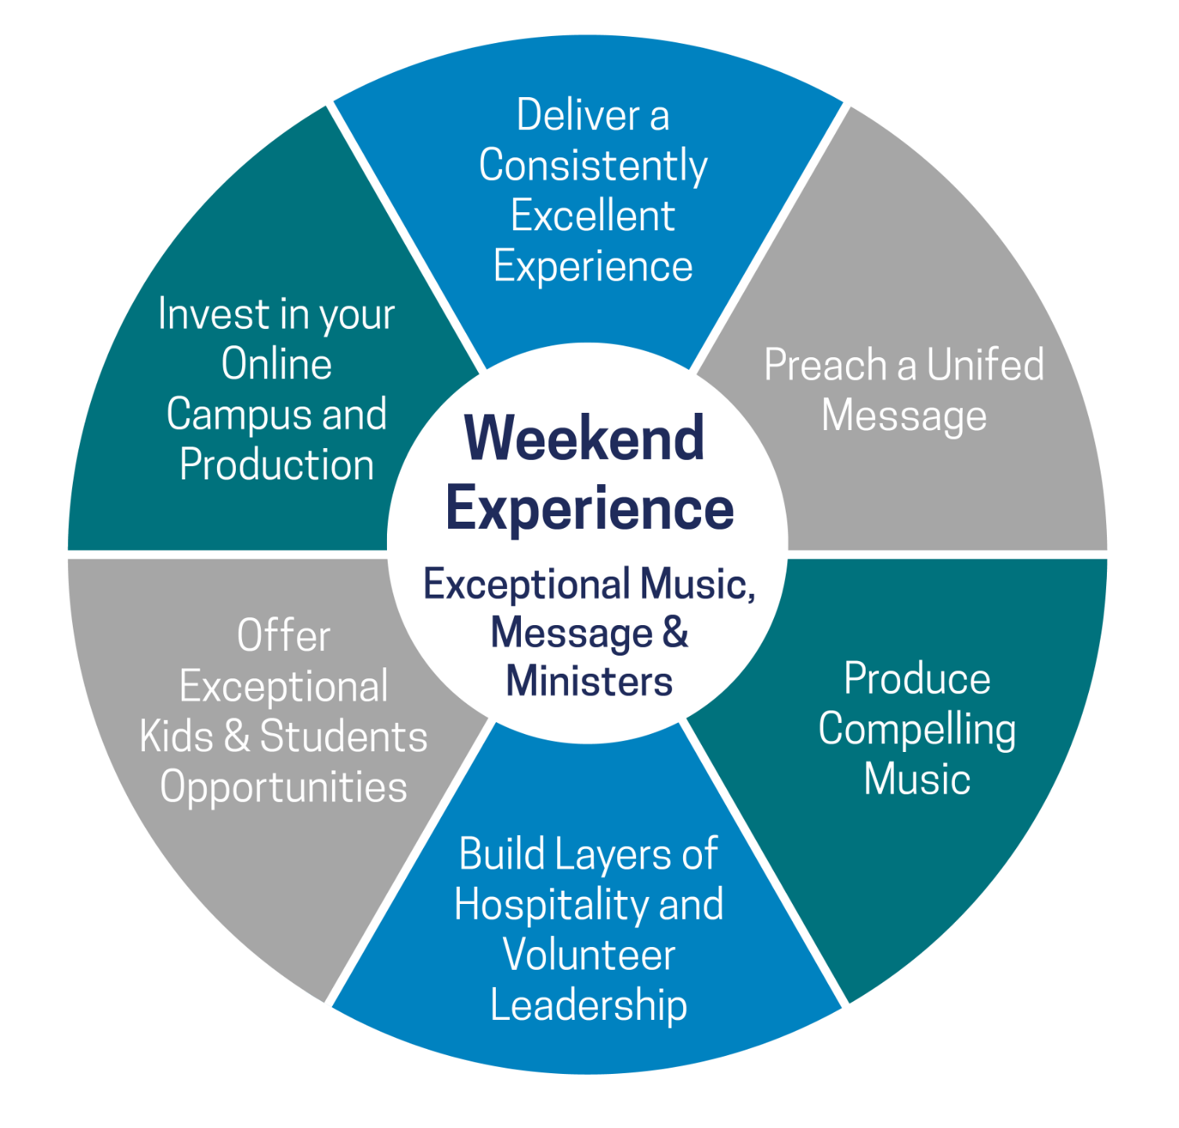
Used from:
www.rebuiltparish.com

Slide 14

Transition team impact
Your ability to communicate effectively about mergers/closings will make all the difference in the success of the newly formed parish.
Effectively communicating involves not only delivering a message but also resonating with the experiences, values, and emotions of those listening.

Slide 15
Planning Transition Center
Learn to infuse energy and passion into your transitions to leave a lasting impression
One of the goals of effective communication and transition is to motivate others into action.
Who | Where | When | What | Communicate
Pillar teams | St. Faustina | Sat. Oct. 12 – 10 am | Radical Hosp. Train | Personal phone call
St. Faustina Parish | St. Faustina Church | Sun. Dec. 15 – 11 am mass | Heritage weekend | Social media, bulletin, parish wide phone call
Family 39 | St. Faustina Church | Sun. Dec. 22 – 11am mass | Closing Liturgy and procession | Pulpit, Homily, social media, news article

Slide 16
Ideas
Merger/Closure
Heritage weekends
Days of Prayer, Reflection
Eucharistic Adoration/Procession
New Parish beginning
Marriage Mass
Eucharistic Adoration/Procession/Benediction
Communicate
Collaborate
Cooperate
Follow through
Establish new habits

Slide 17
Diocese of Buffalo; Guide for parish mergers & closures Revised September 2024 www.roadtorenewal.org rightsize and reshape tab

Slide 18
Thank you
Questions?
Contact us!
Email: renewal@buffalodiocese.org
Website: www.roadtorenewal.org

